Slide 1
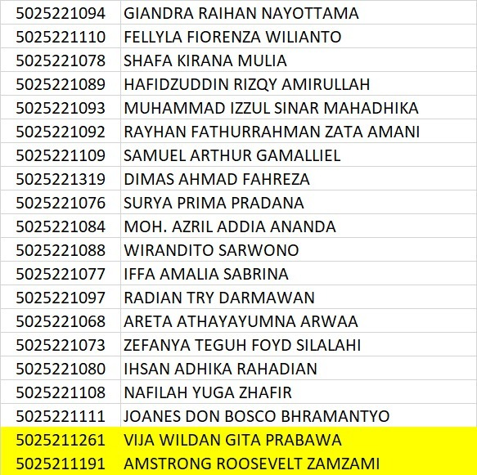
ETS Data Structure- Session 1
You MUST USE STL!!

Slide 3
Session 1 – Bu Aya CHORES
Description:
Bu Aya, married to Pak Aya, manages household chores with limited energy. To maximize efficiency, she prioritizes lower priority tasks. Given the energy and task list, determine her necessary chores.
Input 0 :
10 5
3 sweep_the_house
2 wash_dishes
5 cooking
8 washing_clothes
1 eating
Output 0 :
Bu Aya will do 3 jobs.
eating
wash_dishes
sweep_the_house
Then, Pak Aya Will do 2 Jobs.
cooking
washing_clothes
Input Format :
First Line, there are two numeric values : e and n. The value of 'e' indicates the quantity of energy available, while 'n' represents the number of tasks that Bu Aya needs to perform.
Next N-lines will consist of two numeric values: 'i' and 's'. 'i' denotes the priority of the task, while 's' is a string of characters that describes the name of the task.
Input 1 :
5 3
7 cooking
9 wash_dishes
6 eating
Output 1 :
Pak Aya will do 3 jobs.
eating
cooking
wash_dishes
Output Format:
If Bu Aya is capable of performing at least one task, calculate and display the count of tasks that will be completed by her. Then, print the names of the tasks sorted in ascending order of priority.
If there are any tasks that Bu Aya cannot perform, perform the same operations as before, but after the previous output, add the phrase "then, Pak Aya will do n jobs.”. Then, print the remaining tasks.
If there are no tasks that Bu Aya can perform, then print the count of tasks that will be completed by Pak Aya. Then, print the names of the tasks sorted in ascending order of priority.

